Slide 1
CIMSS/SSEC/UW-Madison JPSS HRD Update
2023/05/17
Liam.Gumley@ssec.wisc.edu

Slide 2
HRD Reception Status Update
SNPP, NOAA-20, and NOAA-21 HRD data are being received at Guam, Honolulu, Madison, Miami, and Mayaguez antenna sites operated by SSEC (all provided by Orbital Systems).
Required updates for NOAA-21 reception included
HRD-200B demodulator firmware updates installed in the field
RT-STPS configuration files were added for NOAA-21
EOS-FES was configured for NOAA-21 scheduling and reception
NOAA-21 HRD has shown no anomalies or performance issues in our local reception.
NOAA-21 HRD from our antennas (and others) was able to help fill the gap for OMPS checkout during the KATX1 outage.
NOAA-21 HRD-derived ATMS and CrIS data are now being supplied to WMO DBNet from SSEC.

Slide 3
CSPP Software Status Update
CSPP SDR v4.0 supporting NOAA-21, NOAA-20, and SNPP was released to the DB community on April 27, 2023 following NOAA “provisional status” declaration for all SDRs.
SDR v4.0 supports VIIRS, CrIS, ATMS, and OMPS RDR to SDR processing.
Multi-core processing is supported (VIIRS pass can be processed in about 2 minutes with 10 cores on a recent Linux server).
Polar2Grid v2.3 supports NOAA-21 VIIRS image creation.
Remaining CSPP software packages will have NOAA-21 support added by end of 2023 in coordination with NOAA/NESDIS/STAR.
http://cimss.ssec.wisc.edu/cspp/

Slide 4
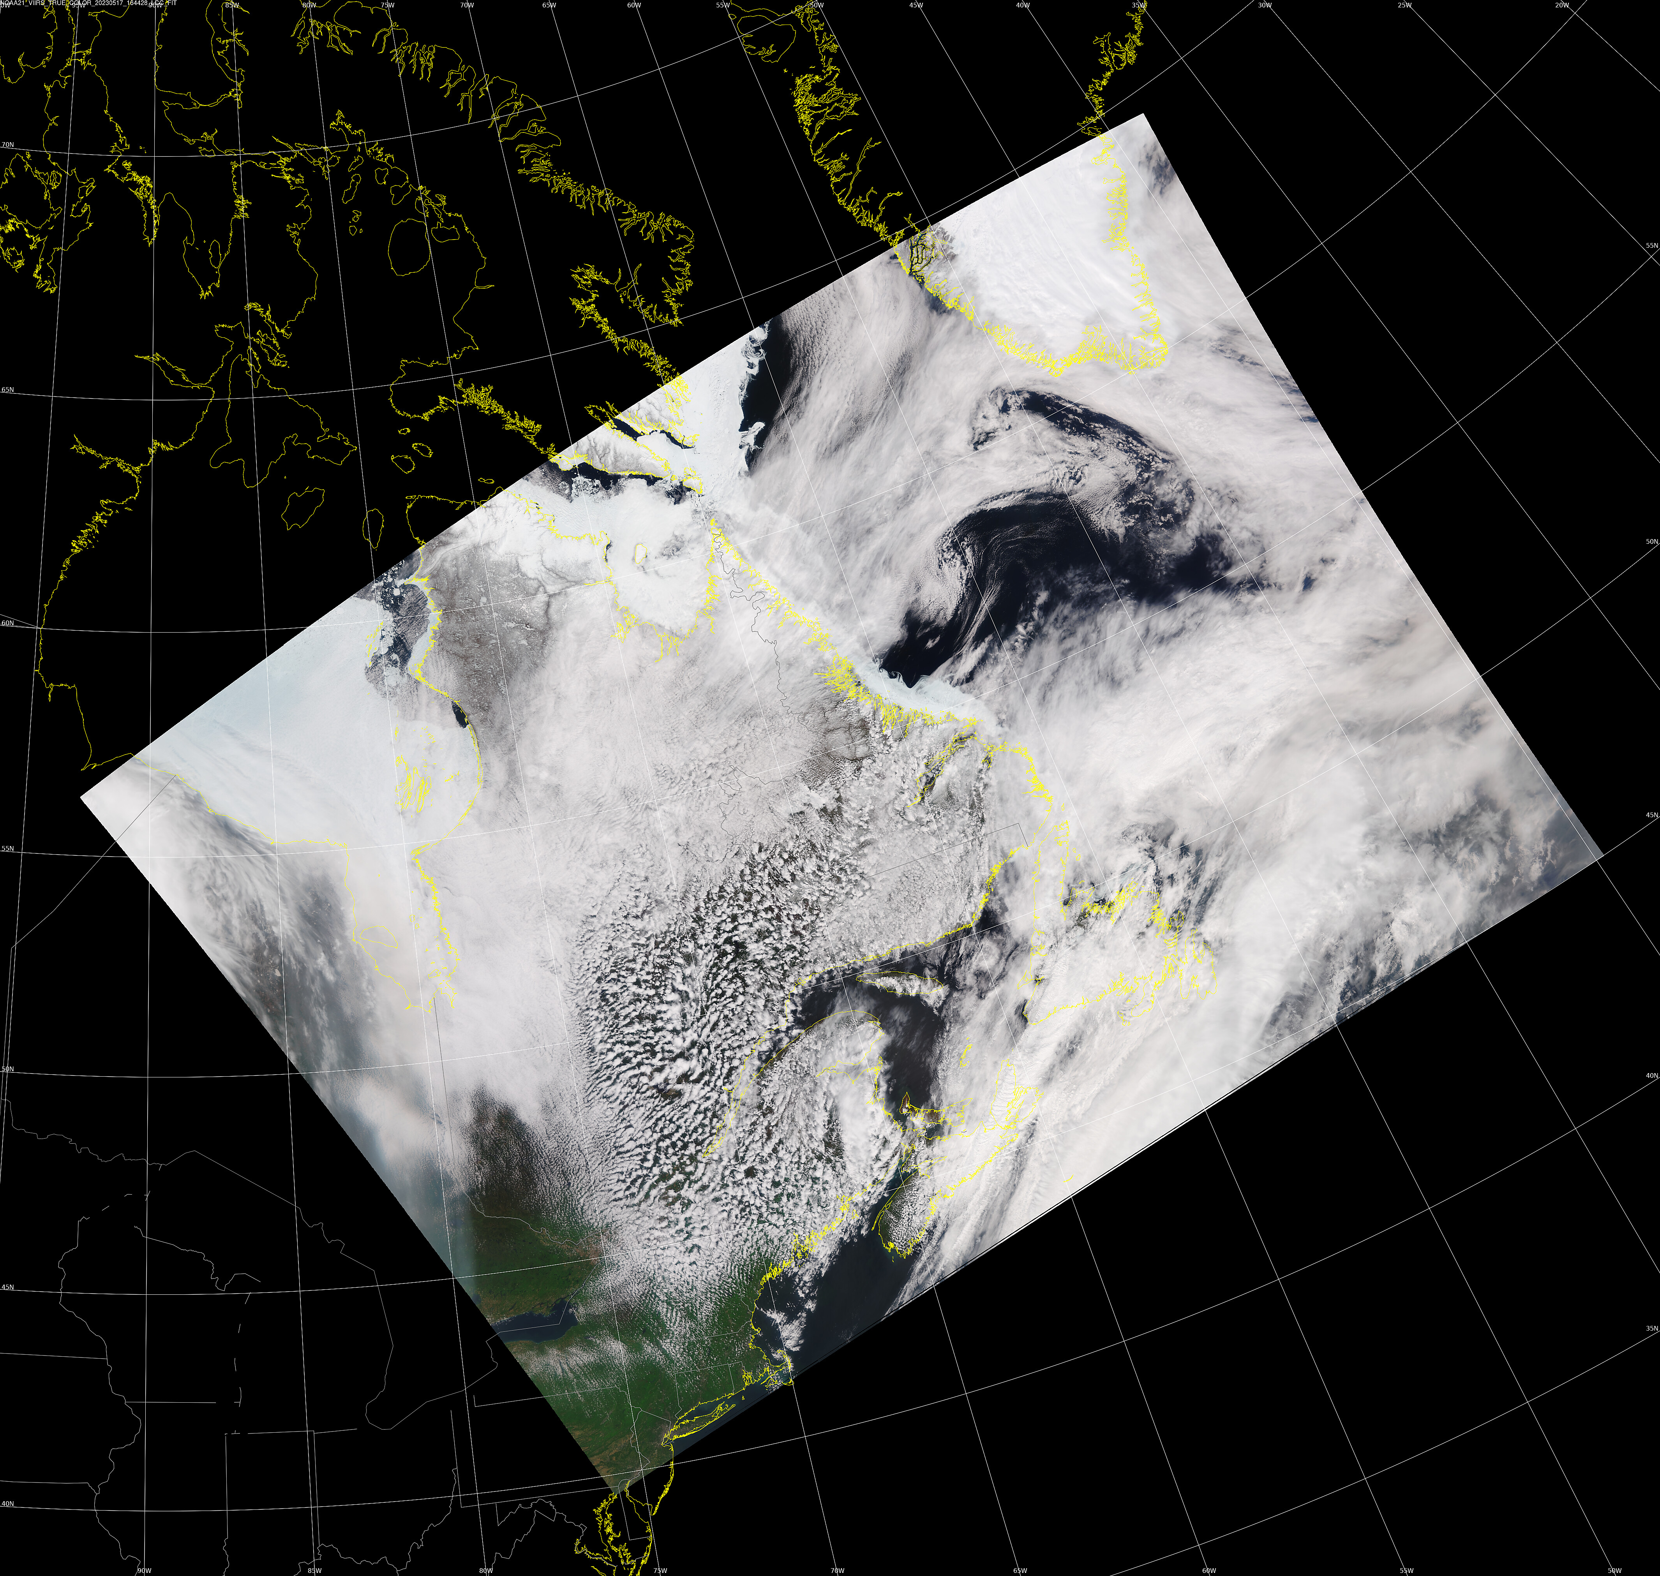
NOAA-21 VIIRS True Color: 2023/05/17 16:44 UTC
Received at SSEC and processed by CSPP SDR v4.0

